Slide 1
Music recommender system
Using word2vec and collaborative filtering
BY: Tanmay Mathur

Slide 2
agenda
Introduction/Problem Statement
Data Description
Algorithms
Results
Future Work

Slide 3
INTRODUCTION
Project Goal : To provide quality music recommendations to user
Data : Usage data from lastfm
Algorithms : word2vec (word embeddings) , Collaborative Filtering (ALS Implicit)
Technology Stack : Spark(Scala), Python (Gensim, Pandas) , ggplot (Visualization)

Slide 4
Data description
Lastfm data : http://www.dtic.upf.edu/~ocelma/MusicRecommendationDataset/lastfm-1K.html
Data Format : userid \t timestamp \t musicbrainz-artist-id \t artist-name \t musicbrainz-track-id \t track-name
Total Events : 4413912
Users : 992
Tracks : 1084873

Slide 5
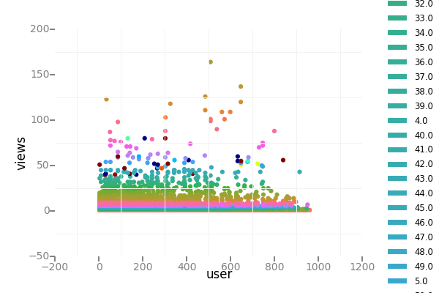
USERS, views and product graph

Slide 6
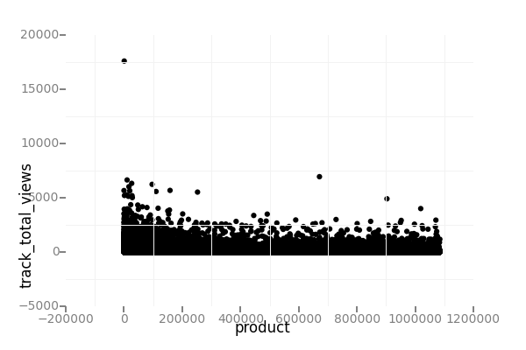
Songs and total views

Slide 7
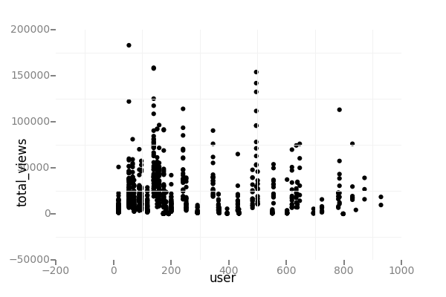
User activity

Slide 8
ALGORITHM
Word Embeddings
Introduced by Bengio a decade ago
W: words→R^{n} is a paramaterized function mapping words in some language to high-dimensional vectors
Notes:
Word embeddings are just a particularly striking example of learning a representation.

Slide 9
GENERATING RECOMMENDATIONS FROM word2vec
Find similar tracks to personalized recommendations based on usage data
Depending on the user mood, they can listen to similar songs in a sequence
Word2Vec requires an input sentence
We create artificial sentences using the sequence in which users viewed the track
Song sequences are created using a window of 30 minutes for every user
Use Gensim default configuration to train the word2vec model
Output is a 200 dimensional vector for all tracks

Slide 10
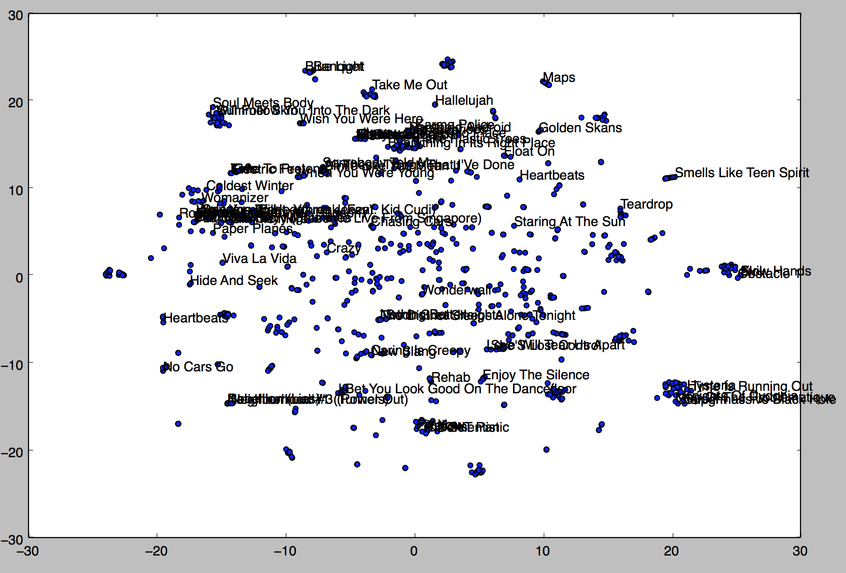
Word2vec visualization

Slide 11
COLLABORATIVE FILTERING USING ALS Implicit
Commonly used for building recommender systems
Needs userId, productId and ratings as input to standard matrix factorization approach based collaborative filtering
Real-world use cases have only implicit feedbacks(clicks, likes, shares, retweets etc.)
ALS Implicit treats the implicit feedbacks as strength of observation
The model finds latent features that is used to predict the expected preference of a user for an item
Notes:
No negative feedback - just because she did not know about the show or was not available to watch it.
Implicit feedback is inherently noisy - we may view purchase behavior for an individual, but this does not necessarily indicate a positive view of the product
Implicit feedback we have to take into account availability of the item, competition for the item with other items, and repeat feedback
. For example, if we gather data on television viewing, it is unclear how to evaluate a show that has been watched more than once, or how to compare two shows that are on at the same time, and hence cannot both be watched by the user.

Slide 12
FINAL ALGORITHM
Find candidates using collaborative filtering for a user
Use the returned candidate list to look for most similar items using the word2vec model
Return N candidates to the user, where N = [M,K]
Different arrangements could be evaluated against user feedback in a live system

Slide 13
Results
The best model was trained with rank = 12 and lambda = 0.1, and numIter = 10, and its RMSE on the test set is 10.764309205205556.
The test mean squared error is = 10.764309205205556

Slide 14
ALGORITHM OUTPUT
Songs recommended for you:
1: Neighborhood #3 (Power Out)
2: Rebellion (Lies)
3: Keep The Car Running
4: Untitled
5: Such Great Heights
6: Neighborhood #1 (Tunnels)
7: Karma Police
8: Heartbeats
9: Neighborhood #2 (Laika)
10: Une Année Sans Lumière
11: Neighborhood #2 (Laika)
12 : Crown Of Love
13: Une Année Sans Lumière

Slide 15
FUTure work
Change the window size and tune the model
Take season, and times(Mornings, Afternoon, Evenings, Night) in to consideration.

Slide 16
QUESTIONS?

